Slide 1
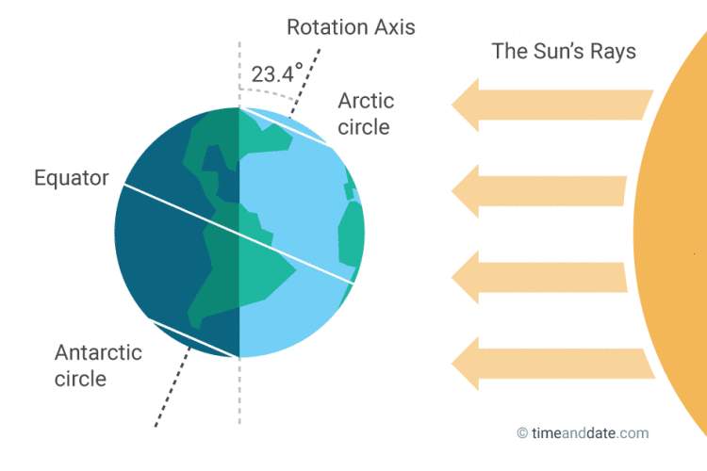
Daily Review
Seasons
The Earth’s axis is tilted at an angle of 23.5°.
This means that as the Earth orbits the sun, certain parts of the world are tilted either towards or away from the sun. This is what causes seasons.
Which season is the Southern Hemisphere experiencing in the diagram?
Which season is the Northern Hemisphere experiencing?

Slide 2
Nyoongar Seasons
Year 7 Earth and Space Science

Slide 3
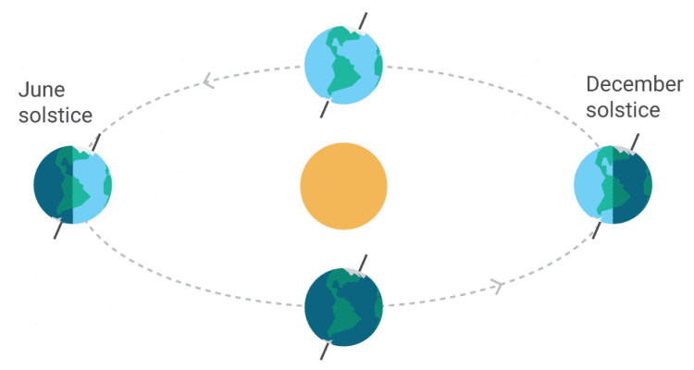
So far, you have learnt that there are 4 seasons:
When part of the world is tilted towards the sun, the weather gets hotter and we call these times summer.
When part of the world is tilted away from the sun, the opposite to summer occurs. The weather is cooler and we call these times winter.
Autumn occurs after summer and before winter.
Spring occurs after winter and before summer.
autumn
winter
summer
spring

Slide 4
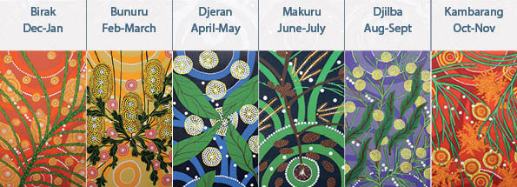
The Nyoongar people of WA also noticed a yearly cycle of changes in the weather.
They created a more specific yearly calendar that helped them to predict not only the weather, but also help guide them to move to areas with better food and water availability.

Slide 5
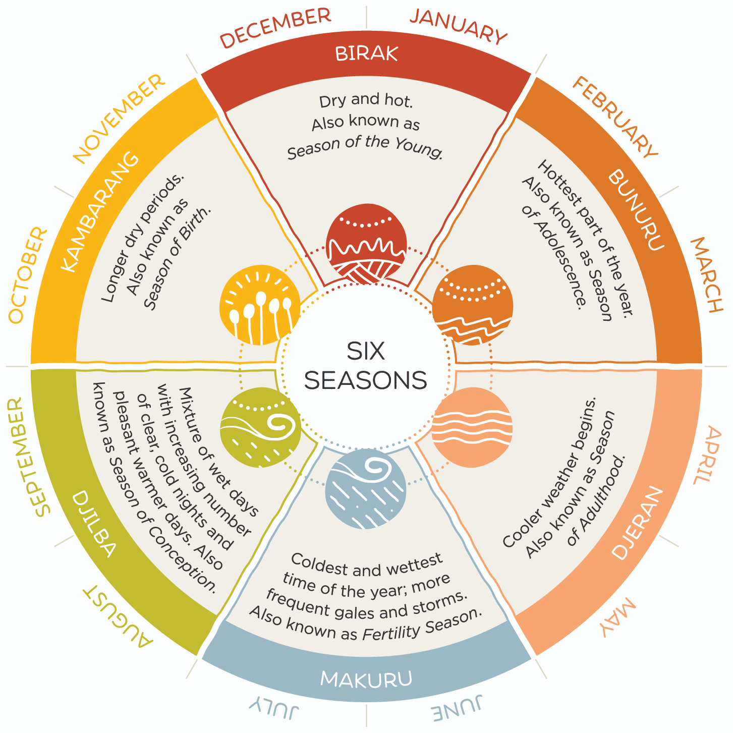
Your task is to create one piece of a larger poster, by concentrating on one of the Nyoongar seasons.
You will then combine your poster with the 5 other seasons to create the complete Nyoongar seasonal calendar.
Lesson 1
Split into groups of 6 and choose one of the 6 Nyoongar seasons each.
Individually, use your device to research your given season and complete the note-taking sheet.
Use a blank A4 sheet to plan your design. (You may want to discuss with the 5 other group members about your overall poster’s design).

Slide 6
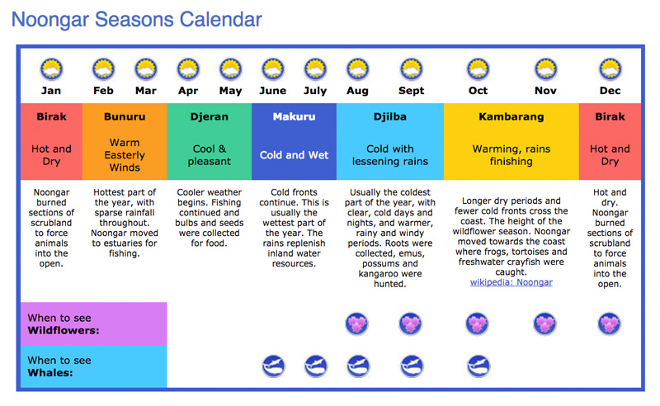
Your task is to create one piece of a larger poster, by concentrating on one of the Nyoongar seasons.
You will then combine your poster with the 5 other seasons to create the complete Nyoongar seasonal calendar.
Lesson 2
Use your draft and note-taking sheet to create your poster on a blank A3 sheet of paper.
Combine your posters to create the complete Nyoongar calendar.

Slide 7
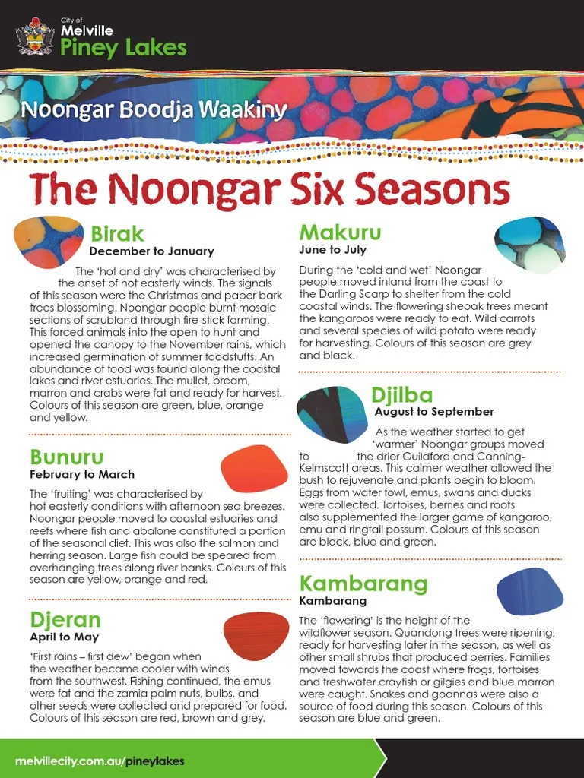
Remember: a poster is an effective way of displaying information.
They should be eye-catching and informative.
Effective posters have common features:
A title (often, but not always at the top)
Small amounts of information in clear sections
Easy to read writing style and size
Images related to the topic
Enough colour to make it interesting, but not too much to make it distracting
Spaced out so it fills the whole page

